Slide 1




KS4 Mathematics
S2 Pythagorean Triples

Slide 2

Pythagorean triples
A triangle has sides of length 3 cm, 4 cm and 5 cm.
Does this triangle have a right angle?
Using Pythagoras’ Theorem, if the sum of the squares on the two shorter sides is equal to the square on the longest side, the triangle has a right angle.
3² + 4² = 9 + 16
= 25
= 5²
Yes, the triangle has a right-angle.
The numbers 3, 4 and 5 form a Pythagorean triple.
Notes:
Explain that a Pythagorean triple is three whole numbers that obey Pythagoras’ Theorem. Many Pythagorean triples where known to people in ancient times.

Slide 3
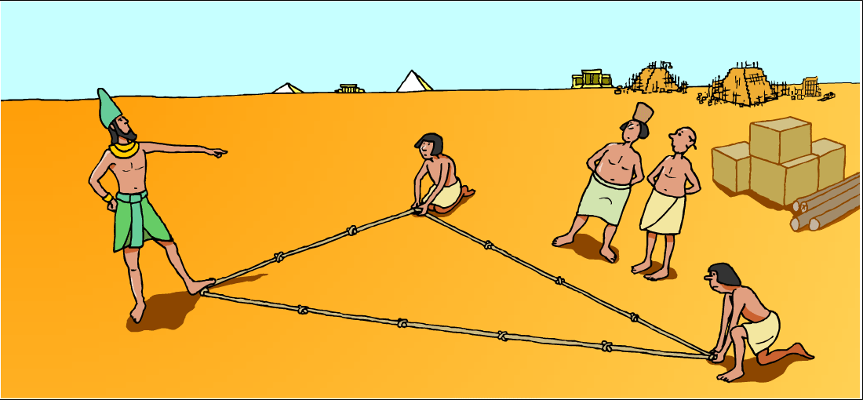
Pythagorean triples
Ancient Egyptians used the fact that a triangle with sides of length 3, 4 and 5 contained a right-angle to mark out field boundaries and for building.

Slide 4
Pythagorean triples
Three whole numbers a, b and c, where c is the largest, form a Pythagorean triple if,
a² + b² = c²
3, 4, 5 is the simplest Pythagorean triple.
Write down every square number from 1² = 1 to 20² = 400.
Use these numbers to find as many Pythagorean triples as you can.
Write down any patterns that you notice.
Notes:
Pupils should be able to find six Pythagorean triples using these numbers. These are shown on the next slide.
They may notice that some of these are multiples of the 3, 4, 5 triangle.

Slide 5
Pythagorean triples
How many of these did you find?
9 + 16 = 25
3² + 4² = 5²
3, 4, 5
36 + 64 = 100
6² + 8² = 10²
6, 8, 10
25 + 144 = 169
5² + 12² = 13²
5, 12, 13
81 + 144 = 225
9² + 12² = 15²
9,12, 15
64 + 225 = 289
8² + 15² = 17²
8, 15, 17
144 + 256 = 400
12² + 16² = 20²
12, 16, 20
The Pythagorean triples 3, 4, 5;
5, 12, 13
and 8, 15 17
are called primitive Pythagorean triples.
Notes:
Pupils should notice that the Pythagorean triples that have not been circled are multiples of the the 3, 4, 5 Pythagorean triple.
Tell pupils that a primitive Pythagorean triple is a Pythagorean triple that is not a multiple of another Pythagorean triple.
Ask pupils to explain why any multiple of a Pythagorean triple must be another Pythagorean triple (using similar triangles).

Slide 6
Similar right-angled triangles
The following right-angled triangles are similar.
10
15
?
6
9
8
12
?
Find the lengths of the missing sides.
Check that Pythagoras’ Theorem holds for both triangles.
Notes:
Remind pupils that the corresponding lengths in two mathematically similar shapes are always in the same ratio. That is, one shape is an enlargement of the other.
Ask pupils if they can work out which Pythagorean triple both these triangles are based on.
For the first triangle, 6 and 8 share a common factor of 2. Dividing these lengths by 2, gives us 3 and 4.
For the second triangle, 9 and 15 share a common factor of 3. Dividing these lengths by 3, gives us 3 and 5.
These triangles are both enlargements of a right-angled triangle with sides of length 3, 4 and 5.
Use this to find the lengths of the missing sides.
Alternatively, we could use a scale factor of ³/₂ to scale from the smaller triangle to the larger triangle, or a scale factor of ²/₃ to scale from the larger triangle to the smaller triangle.

Slide 7
Similar right-angled triangles
The following right-angled triangles are similar.
10
15
?
6
9
8
12
?
6² + 8² =
36 + 64
9² + 12² =
81 + 144
= 100
= 225
= 10²
= 15²
Notes:
Check the lengths of the missing sides by showing that Pythagoras’ Theorem holds for both triangles.

Slide 8
Similar right-angled triangles
The following right-angled triangles are similar.
60
45
?
32
?
24
68
51
Find the lengths of the missing sides.
Check that Pythagoras’ Theorem holds for both triangles.
Notes:
Ask pupils if they can work out which Pythagorean triple both these triangles are based on.
For the first triangle, 60 and 68 share a common factor of 4. Dividing these lengths by 4, gives us 15 and 17.
For the second triangle, 24 and 51 share a common factor of 3. Dividing these lengths by 3, gives us 8 and 17.
These triangles are both enlargements of a right-angled triangle with sides of length 8, 15 and 17.
Use this to find the lengths of the missing sides.
Alternatively, we could use a scale factor of ³/₄ to scale from the larger triangle to the smaller triangle, or a scale factor of ⁴/₃ to scale from the smaller triangle to the larger triangle.

Slide 9
Similar right-angled triangles
The following right-angled triangles are similar.
60
45
32
24
68
51
32² + 60² =
1024 + 3600
24² + 45² =
576 + 2025
= 4624
= 2601
= 68²
= 51²
Notes:
Pupils can verify these calculations using their calculators.
Make sure that pupils can locate both the x² key and the √ key on their calculators.

Slide 10
Similar right-angled triangles
The following right-angled triangles are similar.
2.4
1.8
2
1.5
?
2.5
?
3
Find the lengths of the missing sides.
Check that Pythagoras’ Theorem holds for both triangles.
Notes:
Ask pupils if they can work out which Pythagorean triple both these triangles are based on.
For the first triangle, 2 and 1.5 are half of 4 and 3 respectively.
For the second triangle, 2.4 and 3 are ³/₅ of 4 and 5 respectively.
These triangles are both fractional enlargements of a right-angled triangle with sides of length 3, 4 and 5.
Use this to find the lengths of the missing sides.
Alternatively, we could use a scale factors.
To scale from the smaller triangle to the larger triangle we scale from 2 to 2.4. In other words we would multiply by ^{2.4}/₂ or ⁶/₅ or 1.2.
To scale from the larger triangle to the smaller triangle we scale from 2.4 to 2. In other words we would multiply by ²/_{2.4} or ⁵/₆ or divide by 1.2.

Slide 11
Similar right-angled triangles
The following right-angled triangles are similar.
2
1.5
2.4
1.8
2.5
3
2² + 1.5² =
4 + 2.25
2.4² + 1.8² =
5.76 + 3.24
= 6.25
= 9
= 2.5²
= 3²
Notes:
Conclude by explaining that most Pythagoras problems on the non-calculator paper will involve triangles based on Pythagorean triples. This is because these triangles have side lengths that can be written exactly (the side lengths are rational numbers). Right-angled-triangles that are not based on Pythagorean triples have at least one side length that cannot be written as a terminating or recurring decimal, that is a side length that is irrational. Such lengths can only by written exactly as surds (unresolved roots).
See N4.2 Terminating and recurring decimals and N2.2 Surds

